Slide 1
Milestone 2
Detecting Alzheimer's Disease by Applying Convolutional Neural Network to MRI Scans
Team Thinkers
Dongho Lee
Christian Yan
Professor Barnabas Bede
CSP 200
Fall 2021
Notes:
Hello class, we are team thinkers and we came back with a new project idea for CSP 200. I am Dongho Lee, and I am Christian Yan. This is milestone 2 of our project and it will be about the detection of Alzheimer’s using convolutional neural network on MRI scans.

Slide 2
Outline
Goal
Brief Overview of Convolutional Neural Networks
Naive CNN
Transfer Learning
Basics
VGG16
VGG19
ResNet
Preprocessing: Gaussian Noise
Future Plans
Algorithms
Datasets
Weekly Goals
Notes:
We will first talk about our new project goal, and introduce what we have achieved so far in our 4 approaches.We have tried to build our own convolutional neural network model, and also have tried transfer learning using 3 pretrained models: VGG16, VGG19, and ResNet.
We are also getting to know about preprocessing at this stage, and the first thing we’ve tried is the Gaussian noise layer.
And lastly, we will talk about areas that we still need to improve in.

Slide 3
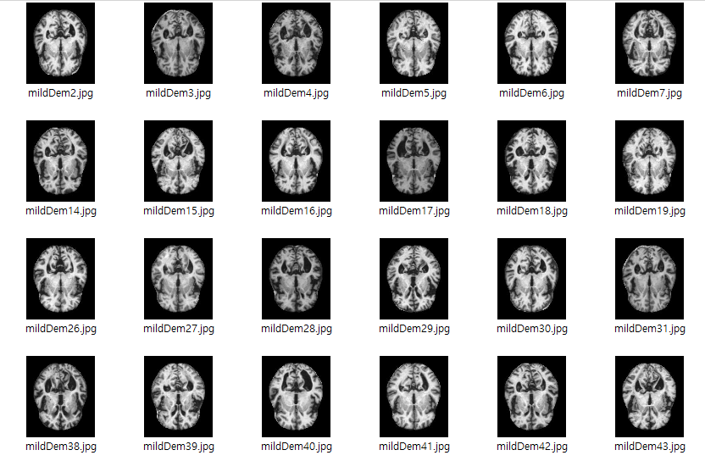
Goal
Create a binary classification system
No dementia
Dementia
Accuracy: 95+ %
Notes:
Our dataset consists of 5121 of MRI scans with dimensions of 176 by 208, which used to be divided into 4 categories depending on severity. But as of now, we have merged the categories into no dementia vs dementia, so we can build a binary classification system. We are aiming for an accuracy of at least 95%

Slide 4

Brief Overview of Convolutional Neural Networks
A convolutional neural network consists of 3 types of layers
1. Convolutional layers 2. Pooling layers 3. Fully connected layer
image source: [1]
Notes:
As we have gone over in the first milestone presentation, we will be utilizing convolutional neural networks, and employ supervised learning.
A convolutional neural network, CNN in short, stacks convolutional layers and pooling layers to make sense of the input image, then feeds it to the neural network, also known as the fully connected layer or the feedforward network.

Slide 5
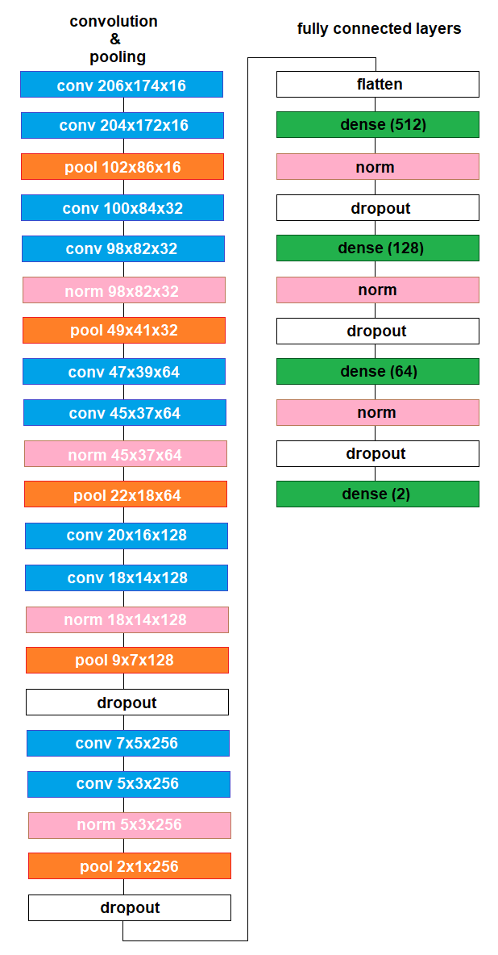
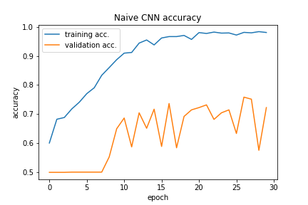
Naive CNN
This is a model built from the ground up
Accuracy: 60-70%
Notes:
The first model was our own creation, and we call it the naive CNN method, the model consists of these layers shown on the right, and as you can see, while the training accuracy, the accuracy of the predictions for training data, was approaching 100%, the validation accuracy, the accuracy of the predictions for new data, was barely reaching 70%.

Slide 6
Transfer Learning
“The weight has been previously initialized by training with other larger datasets such as ImageNet dataset.” Usually, fine-tuning of the model is done in the last few layers ^{[2]}.
Notes:
So we began exploring alternatives with Professor Bede, and Professor Toth’s suggestion to use transfer learning sounded like a good option. Transfer learning is a transfer or, as I’d like to call it, transplanting a functioning model into our model so it already knows its job from the beginning.
The weight has been previously initialized by training with other larger datasets such as ImageNet dataset. Usually, fine-tuning of the model is done in the last few layers.

Slide 7
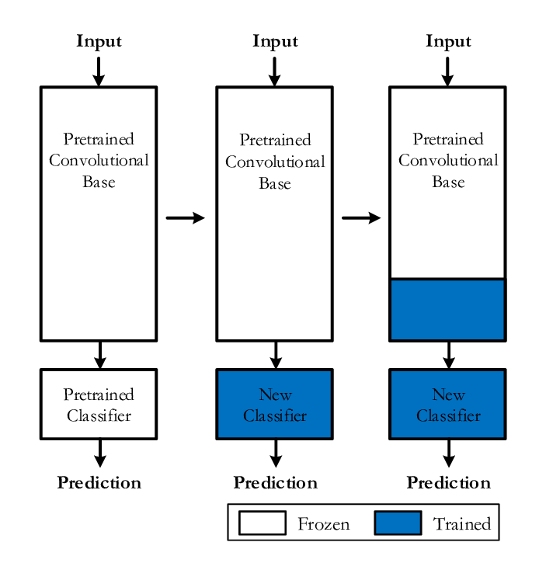
Transfer Learning: Basics
Frozen:
Pretrained extensively using a large dataset (untrainable; not our job)
Trainable:
Part of the pretrained model or our custom layers that need training
image source: [3]
Notes:
To elaborate on what was written in the previous slide, transfer learning consists of two parts, the frozen or untrainable part, and the trainable part.
As the deep learning model keeps producing predictions, it tries to maximize the prediction accuracy by changing its parameters. In case of transfer learning, most or all layers of the pretrained model will be kept as they are, but the last few layers will keep being updated to produce more accurate predictions.
In the diagram, the model on the left cannot be trained at all because everything is frozen. The one in the middle has a trainable classifier (or top layer as it is called in keras). The one on the right even unfroze some part of the pretrained model. We chose the 2nd approach which

Slide 8
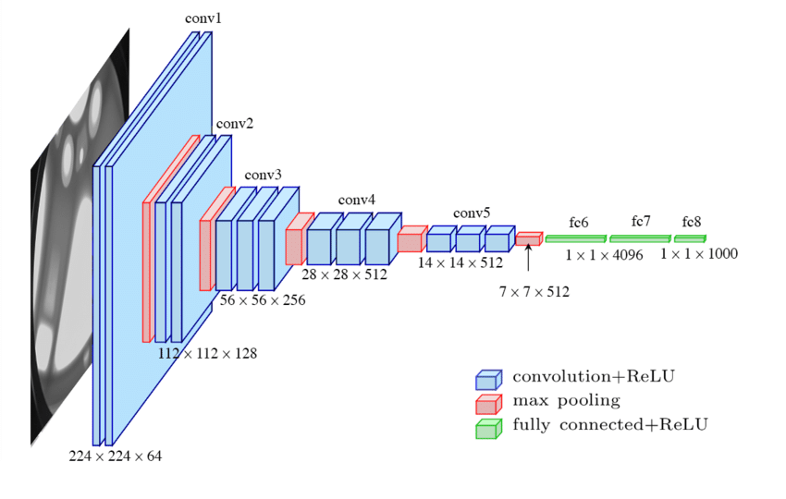
Transfer Learning: VGG16
A convolutional neural network developed by Karen Simonyan and Andrew Zisserman
Input: 224x224x3 image
Output: 1 of the 1000 categories
5 convolution-pooling cycles, each cycle halving the dimensions
image source: [4]
Notes:
This is the first pretrained model that we’ve researched. The diagram on the right shows you what VGG16 looks like. It takes a 224x224 image with RGB values and predicts which of the 1000 categories this image fits into. We will remove the top layer, freeze the rest, and add our own top layer, as shown in the next slide...

Slide 9
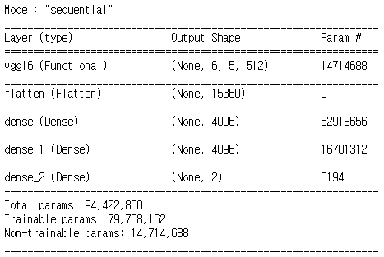
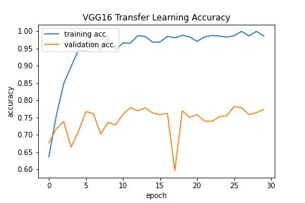
VGG16 Results
Accuracy: 75-80%
Notes:
This is what the model looks like and how well it did. While the training vs validation accuracy still has a wide gap, we managed to increase the accuracy to 75-80%.

Slide 10
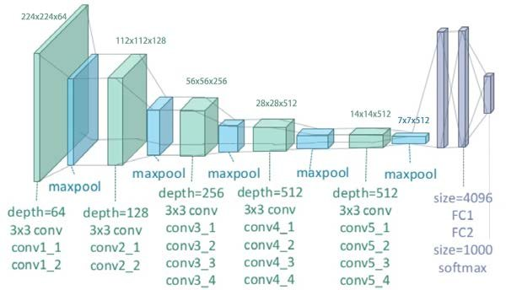
Transfer Learning: VGG19
Same input and output formats as VGG16
5 cycles of convolution and pooling
One more convolutional layer in the last 3 cycles
image source: [5]
Notes:
Next one is called the VGG19 model. This model is very similar to VGG16 and has the same input and output formats. But the key difference is that each of the last 3 cycles has one more convolutional layer. We also removed the top layers attached the same layers as we did to VGG16. Let’s see how this affects the outcome of the model.

Slide 11
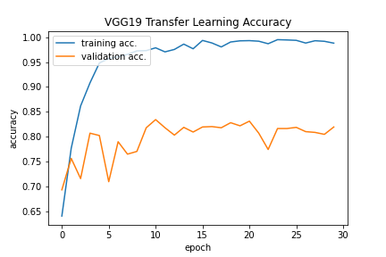
VGG19 Results
Accuracy: 75-80%
Accuracy: 80-85%
Notes:
As you can see, the accuracy of transfer learning with VGG19 was about 5%p higher compared to when we used VGG16. So we can already see that VGG19 is a more promising model for Alzheimer’s diagnosis. But there is one more possibility.

Slide 12
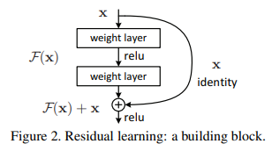
ResNet
Residual Network(ResNet) is a type of neural network.
It utilizes skipping to create deeper networks.
Will go 2 or 3 layers deep depending on the total amount of layers.
Image Source: [6]
Notes:
Helps with vanishing gradient

Slide 13
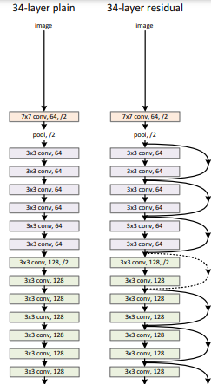
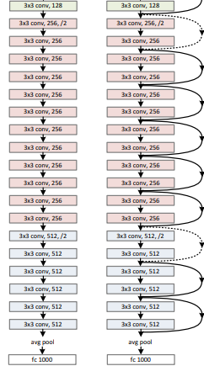
34-Layer Network
This shows an implementation of a plain and residual Network.
The right side of the two images shows a depth of 2 layers.
While the left has no skipping and goes through each layer.
Image Source: [6]

Slide 14
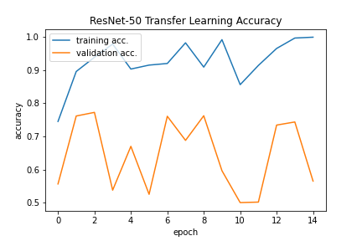
CNN vs ResNet
~70% Validation Accuracy
~58% Validation Accuracy

Slide 15
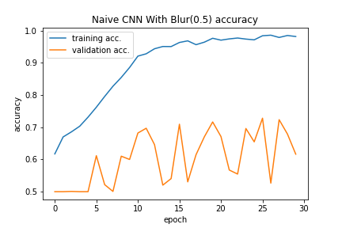
Pre-Processing
We have applied Gaussian Noise to dataset.
This method is used to soften edges in images.
Increased our basic CNN by ~1% for the test accuracy.
Continue to do more pre-processing to help with our overfitting problem.

Slide 16
Future Plans
Algorithm
Resolving Overfitting
Too many trainable parameters -> model follows the training data too closely
Not enough preprocessing
Image Augmentation
Rotate/flip images to make the prediction model more robust
Dataset
Found a new data repository ADNI (Alzheimer's Disease Neuroimaging Initiative)
Planning to explore more on Google, Kaggle, and ImageNet as well
Notes:
If you paid attention to the accuracy graphs, you would notice that validation accuracy is significantly lower than training accuracy. This is a phenomenon known as overfitting, and it can happen when there are too many parameters in the deep learning model, or the training images are not sufficiently preprocessed to create a more reliable model. While working on overfitting, we will also research image augmentation, which expands the dataset using existing images, using tensorflow’s built-in functionalities like ImageDataGenerator.
As for the datasets, we have found a new source called ADNI which stands for Alzheimer’s Disease Neuroimaging Initiative. And we will keep searching on Google, Kaggle, and ImageNet as well.

Slide 17
Weekly Goals
Week # | Dates | Goals
9 | Oct 24-30 | Improvement 1 - address overfitting by varying the number of params & types of preprocessing
10 | Oct 31-Nov 6 | Improvement 2 - dataset augmentation (rotate/flip) and fine-tuning the layers’ setups
11 | Nov 7-13 | Improvement 3 - build a full-sized preprocessor using DBSCAN (detect ventricles and a decrease in brain volume)
12 | Nov 14-20
13 | Nov 21-27 | Train using more diverse datasets (Google, Kaggle, ImageNet, ADNI)
Notes:
This is a table of our weekly goals, which largely consist of 2 parts: improvement milestones on our convolutional neural network, and then a preprocessor milestone.

Slide 18
References
[1] S. Saha, “A comprehensive guide to Convolutional Neural Networks - the eli5 way,” Medium, 15-Dec-2018. [Online]. Available: https://towardsdatascience.com/a-comprehensive-guide-to-convolutional-neural- networks-the-eli5-way-3bd2b1164a53. [Accessed: 25-Oct-2021].
[2] Krishnaswamy Rangarajan, A., Purushothaman, R. Disease Classification in Eggplant Using Pre-trained VGG16 and MSVM. Sci Rep 10, 2322 (2020). https://doi.org/10.1038/s41598-020-59108-x
[3] Khademi, Gholamreza & Simon, Dan. (2019). Convolutional Neural Network for Environmentally Aware Locomotion Mode Recognition of Lower-Limb Amputees.
[4] Ferguson, Max & ak, Ronay & Lee, Yung-Tsun & Law, Kincho. (2017). Automatic localization of casting defects with convolutional neural networks. 1726-1735. 10.1109/BigData.2017.8258115.
[5] Zheng, Yufeng & Yang, Clifford & Merkulov, Aleksey. (2018). Breast cancer screening using convolutional neural network and follow-up digital mammography. 4. 10.1117/12.2304564.
[6] K. He, X. Zhang, S. Ren, and J. Sun, “Deep Residual Learning for Image Recognition,” arxiv.org, 10-Dec-2015. [Online]. Available: https://arxiv.org/pdf/1512.03385.pdf. [Accessed: 26-Oct-2021].

Slide 19

Thank you
Any Questions?

